Slide 1
A Comparative Study of Dimension Reduction Techniques- PCA, ICA, LDA and NMF in Facial Recognition using SVM Classifier
Artificial Intelligence: CS7IS2
Prateek Tulsyan- 19303677
Mrinal Jhamb - 19301913
Shubham Dhupar - 19304374
Rushikesh Joshi - 19300976
Notes:
The advancements in contemporary technologies imply that Face Recognition is becoming increasingly important application of Artificial Intelligence. Amalgamating AI with Computer Vision enables commercial systems to perform face recognition in real-time speed. Drilling down into these systems reveals that there’s a two-step process involved in face recognition, Subspace projection (dimensionality reduction) followed by performing Classification.

Slide 2
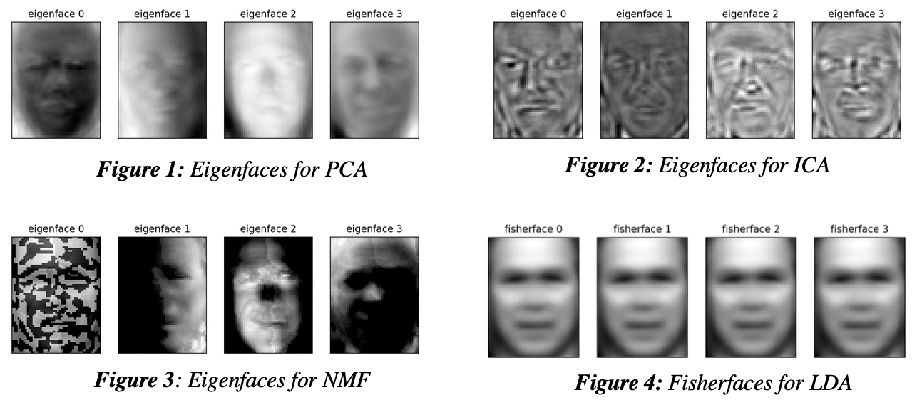
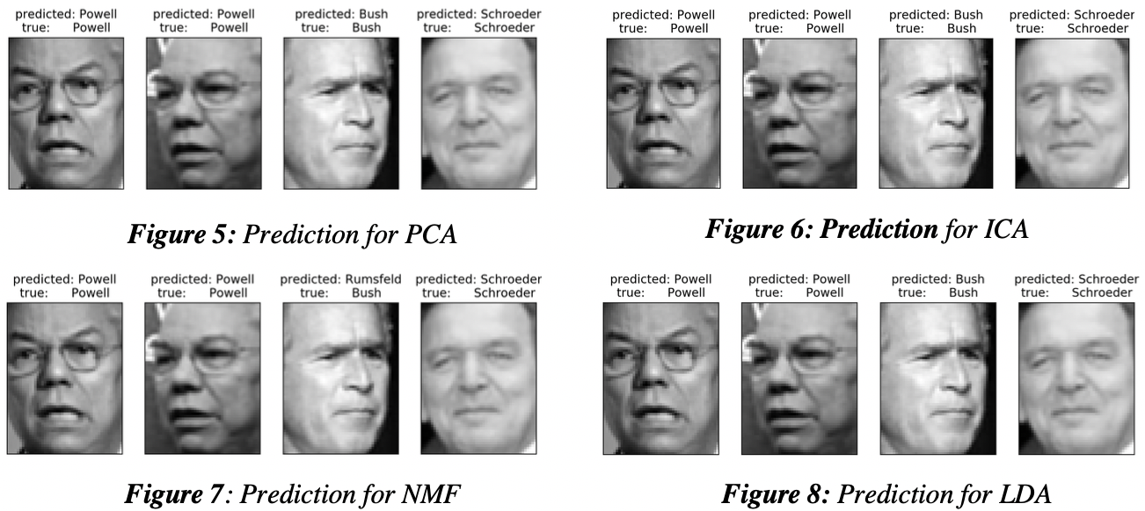
Dimensionality Reduction/Prediction
PCA: Eigenfaces generated captures global features like brightness, avg. eigenfaces and that each next eigenface has less information and more noise
ICA: Eigenfaces generated captures localized features like nose, eye selectors
NMF: Produced sparsely information rich eigenfaces as per its inherent property due to sparsely positively populated decomposed matrices
LDA: Scatter between classes is greater in fisherfaces than in eigenfaces
SVM Classifier: Widely used and works on the idea of separating members of different class using decision planes.
Notes:
Algorithms for dimensionality reduction largely affect the accuracy of face recognition systems. For the scope of this paper, four prominent algorithms, Principal Component Analysis (PCA), Independent Component Analysis (ICA), Non -negative Matrix Factorization (NMF) and Linear Discriminant Analysis (LDA) have been chosen for comparison. These are used in conjunction with the SVM classifier to perform face recognition on the ‘labelled faces in the wild’ dataset.
These algorithms have been handpicked due to the contradicting results available in numerous research papers comparing them.

Slide 3
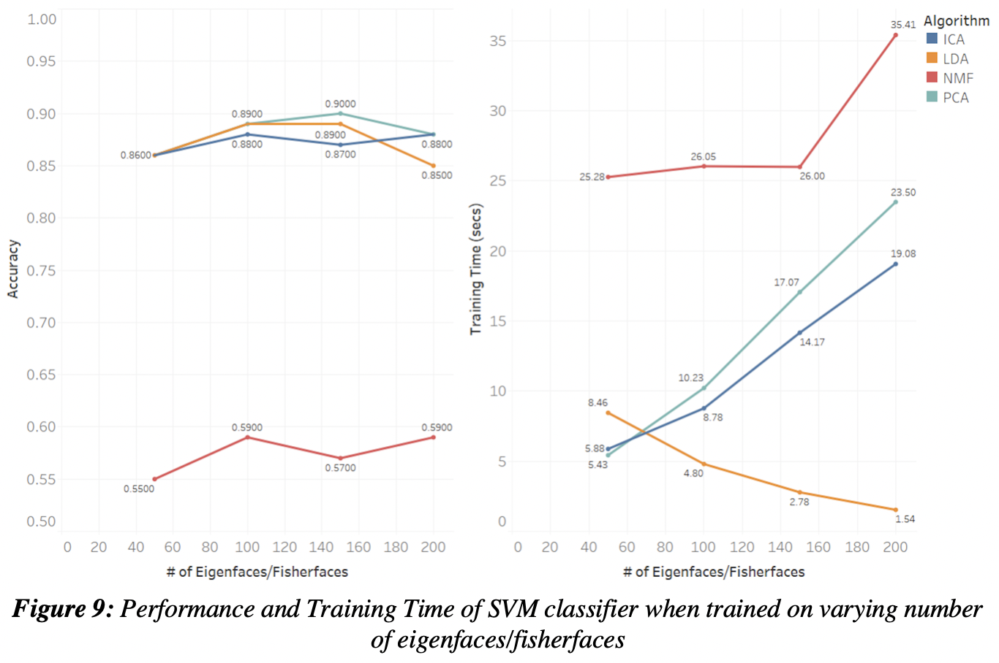
Results/Observations
NMF is the worst in terms of accuracy of prediction and training time
PCA performs the best with prediction accuracy of 90%
LDA performs the best for 200 fisherfaces taking around 1.54 seconds
For LDA, time taken to train the model kept on decreasing with increasing number of fisherfaces
Based on the trade-off between accuracy of prediction and the time it took for the model
to be trained on the generated eigenfaces/fisherfaces, LDA performed best for 150
fisherfaces and had accuracy of 89% and training time of 2.78 seconds.

